Slide 1

Project 2 SAS
Descriptive Analytics with SAS
IDC4252C-2032
Karah Culley

Slide 2

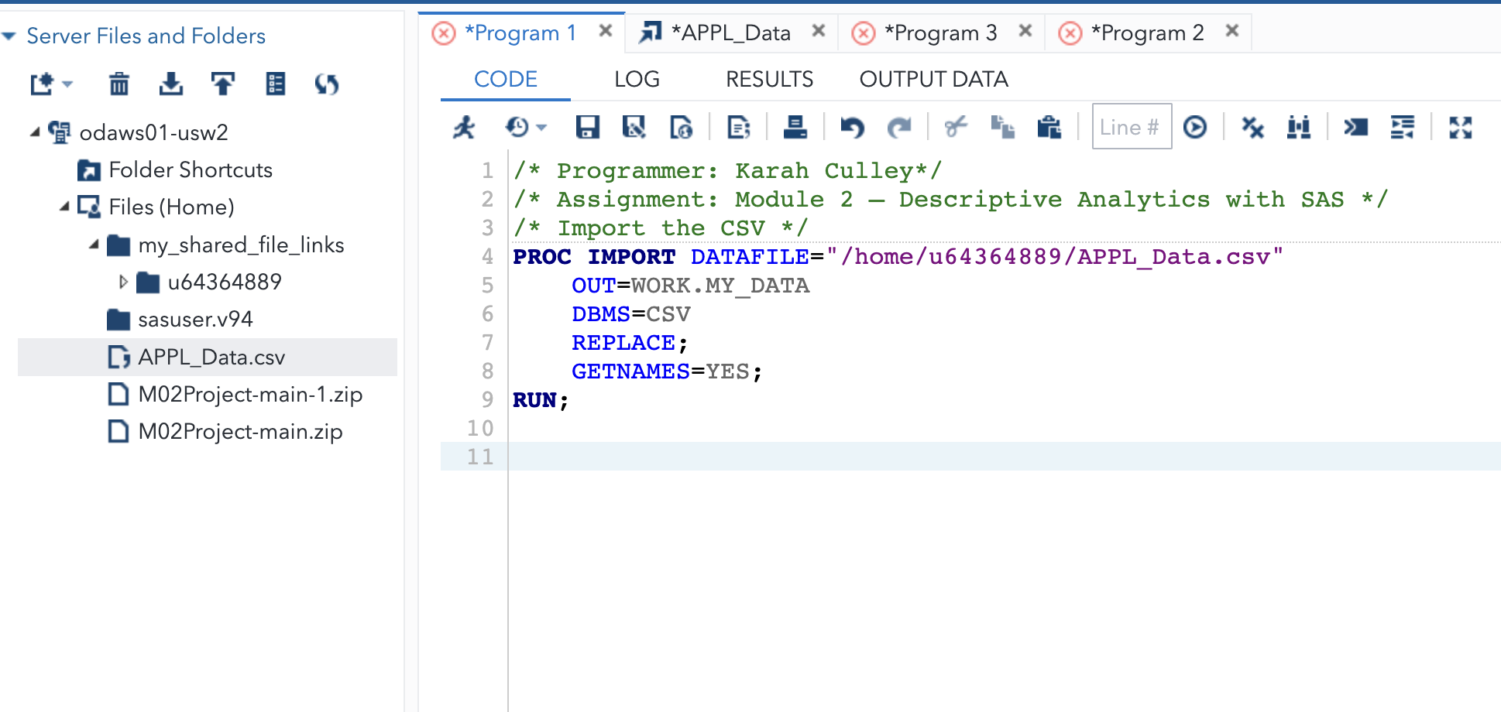



Data Import
The dataset was imported from a CSV file into SAS using PROC IMPORT

Slide 3
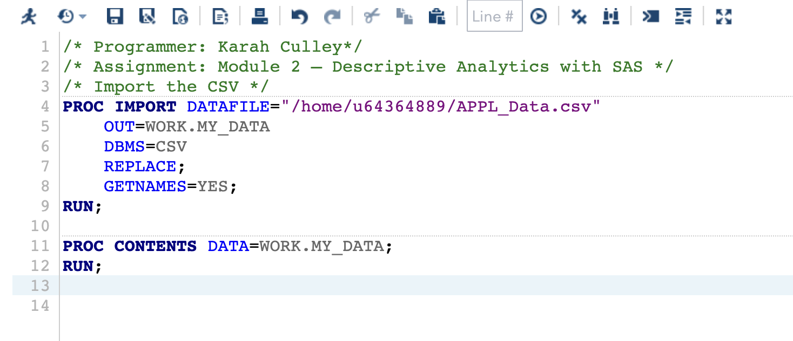
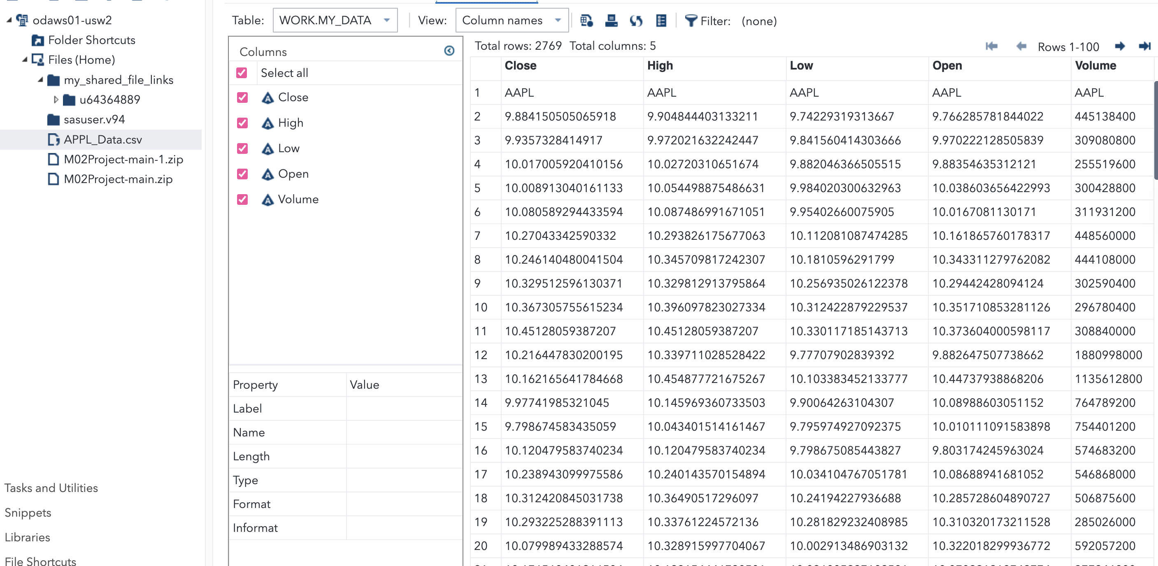
Proc Contents
Output:
Data Validation:
PROC CONTENTS was used to examine the structure of the dataset, including variable names, types, and attributes. This step confirmed that numeric variables needed conversion prior to descriptive analysis.

Slide 4
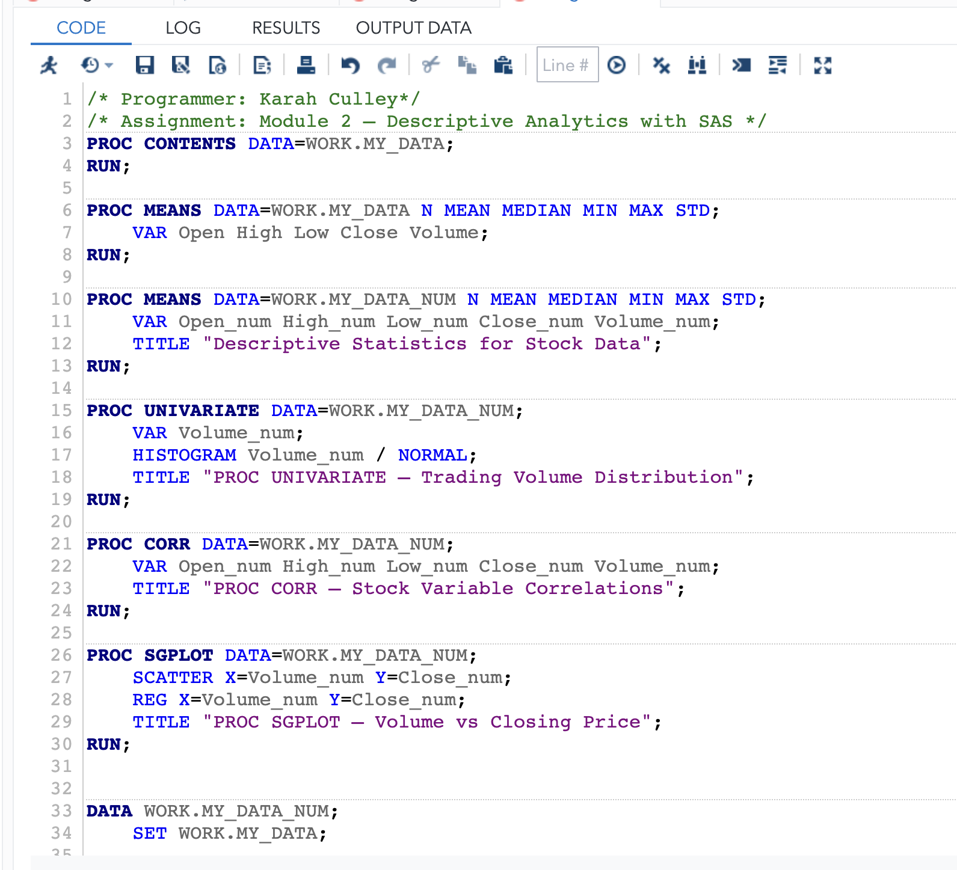
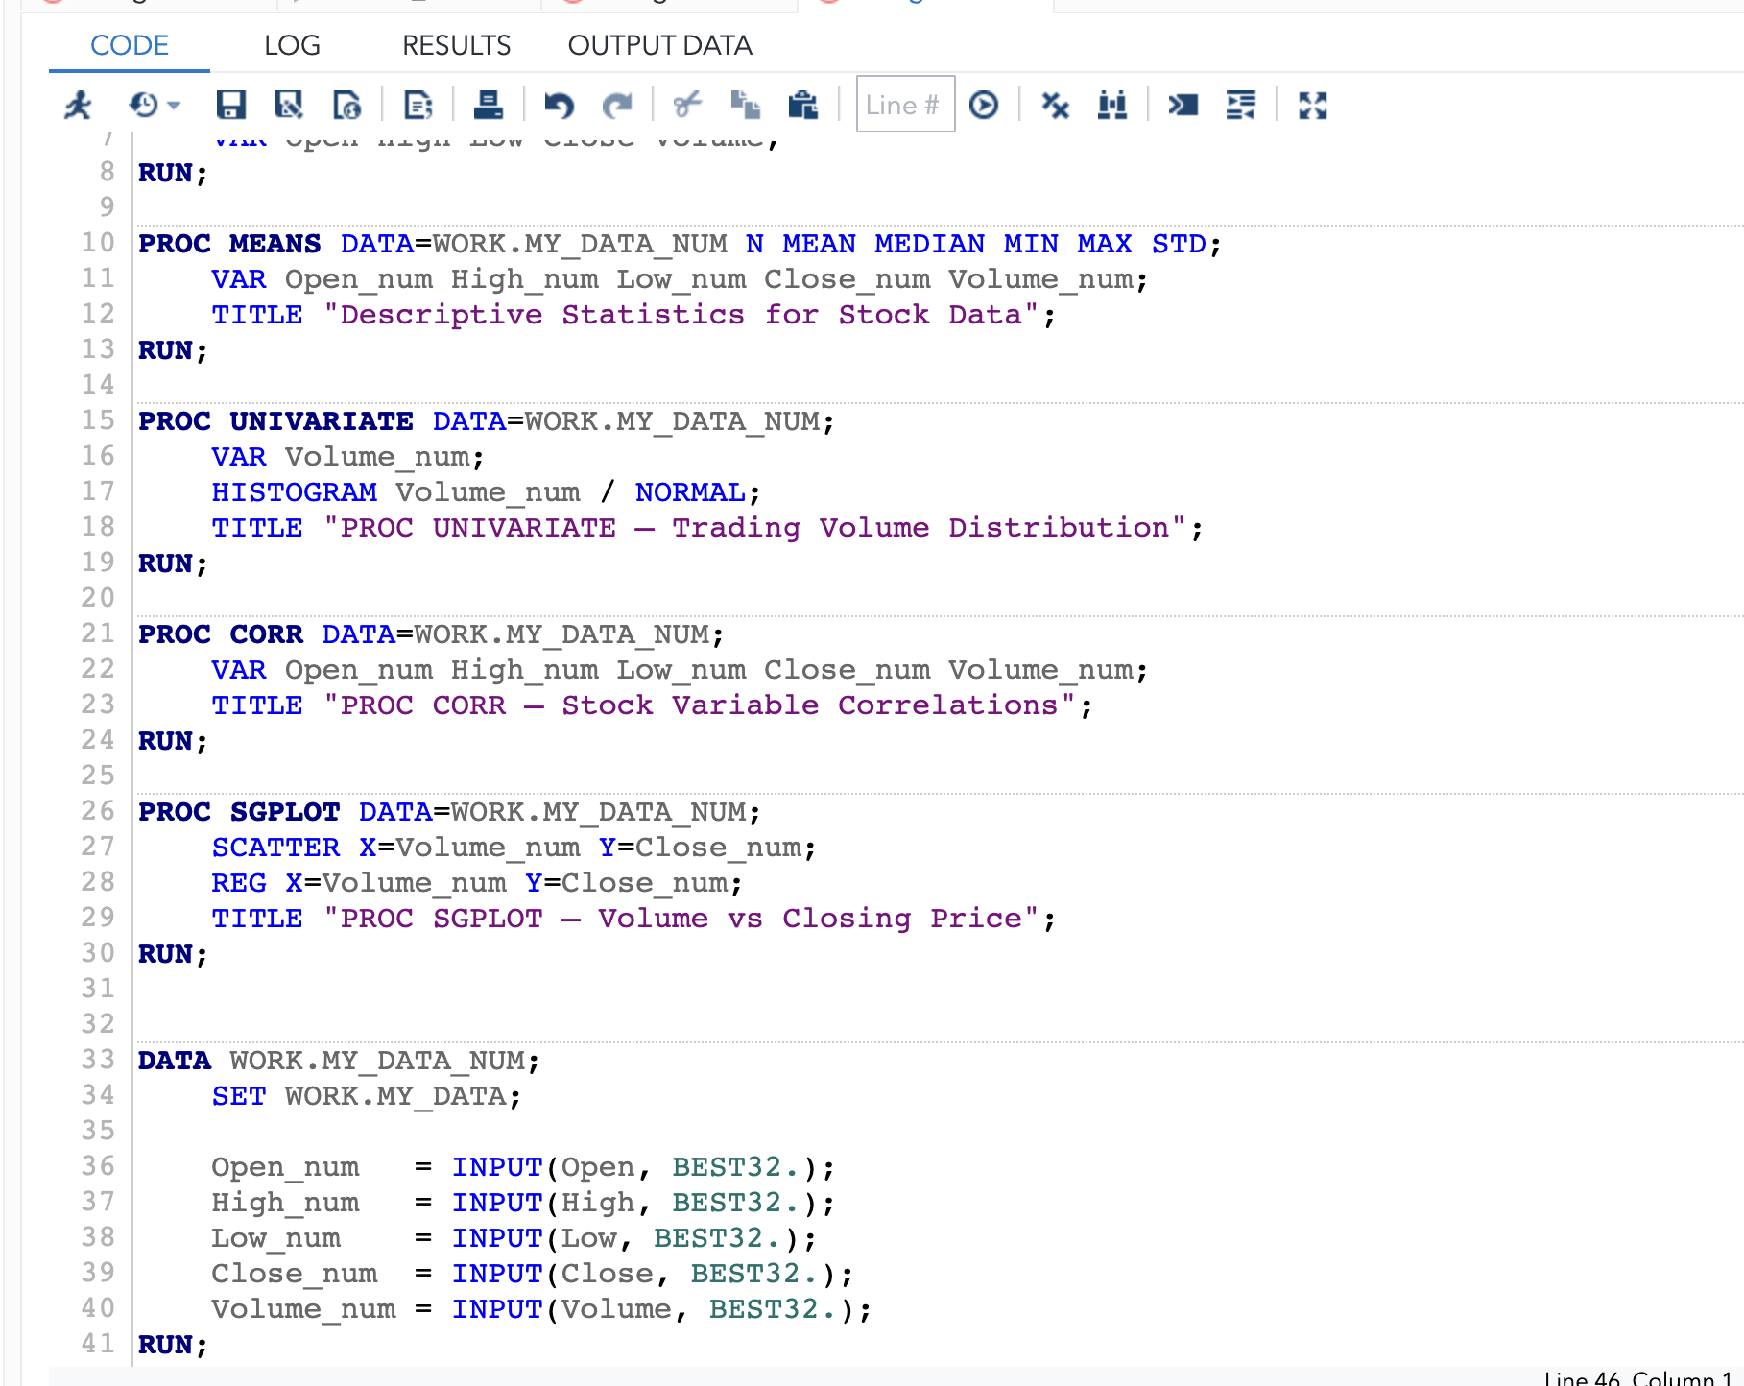
A look at all the Proc codes that will be ran and explained in the following slides:

Slide 5
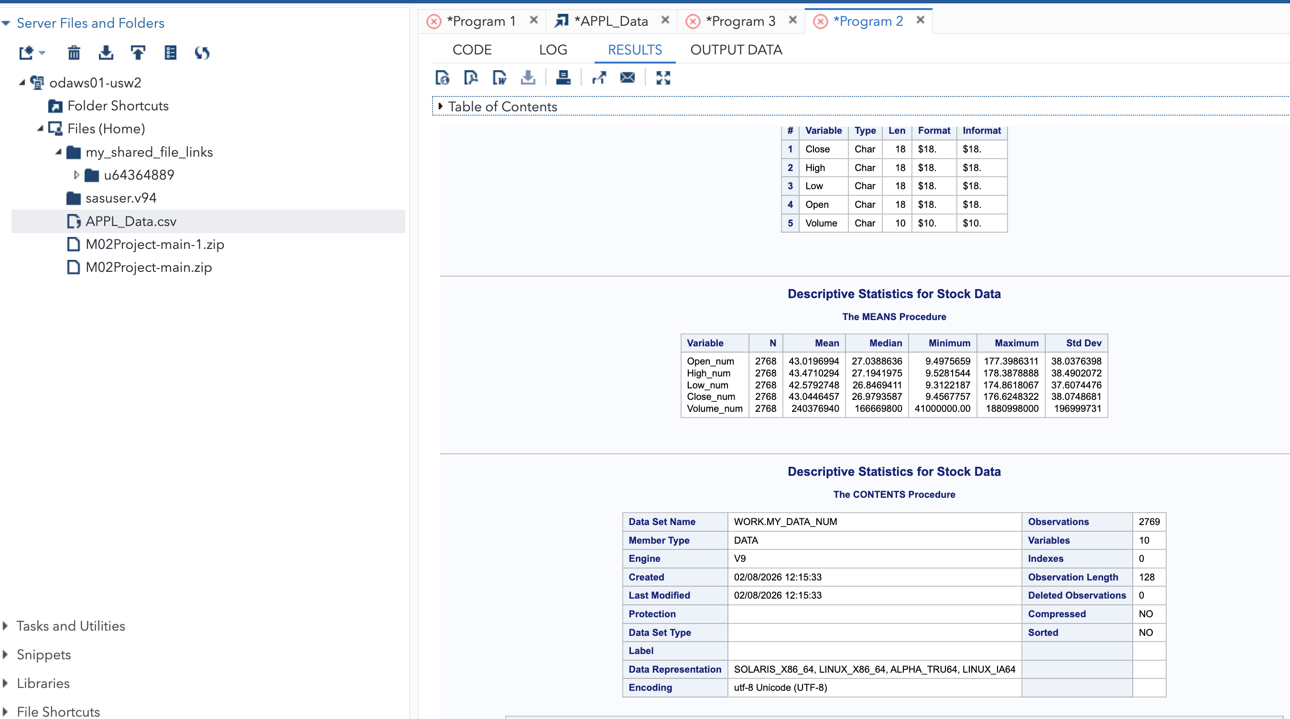
Proc Means
PROC MEANS was used to calculate key descriptive statistics for the stock variables, including measures of central tendency and dispersion. The exact code ran can be referenced in the previous slide. Below is the output:

Slide 6
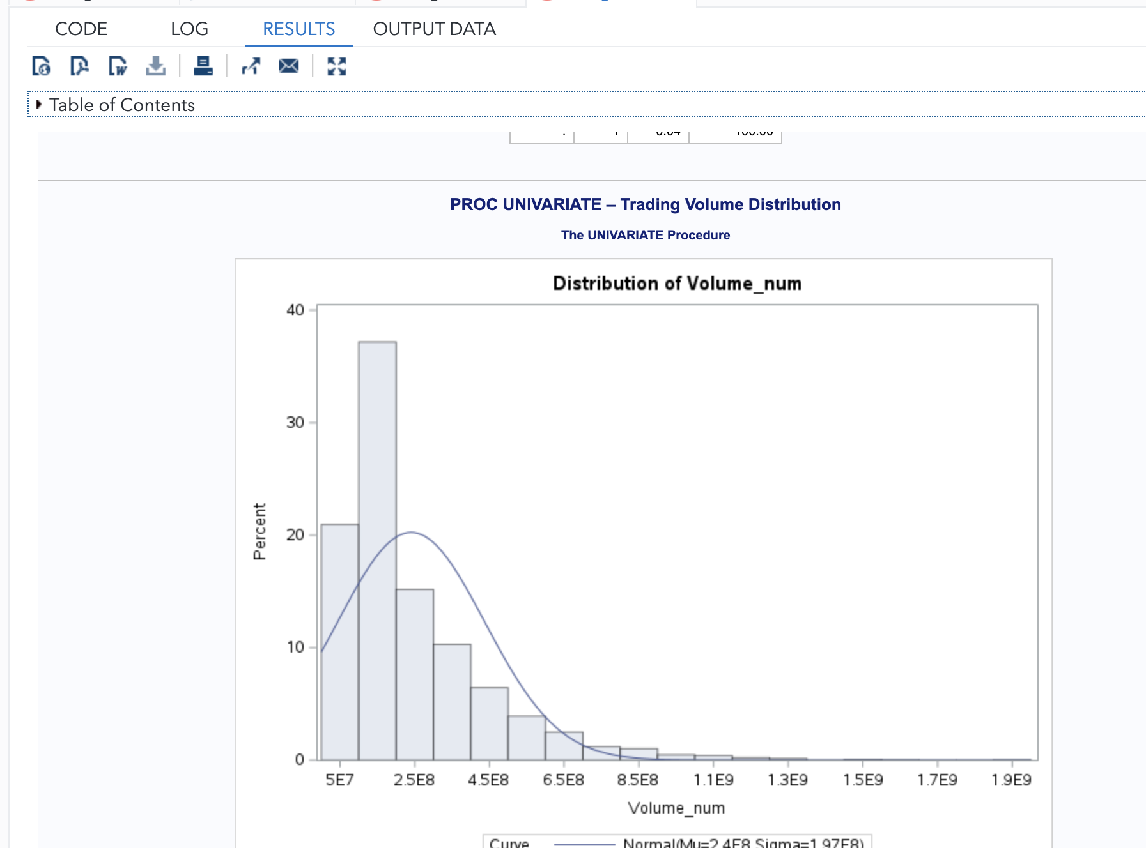
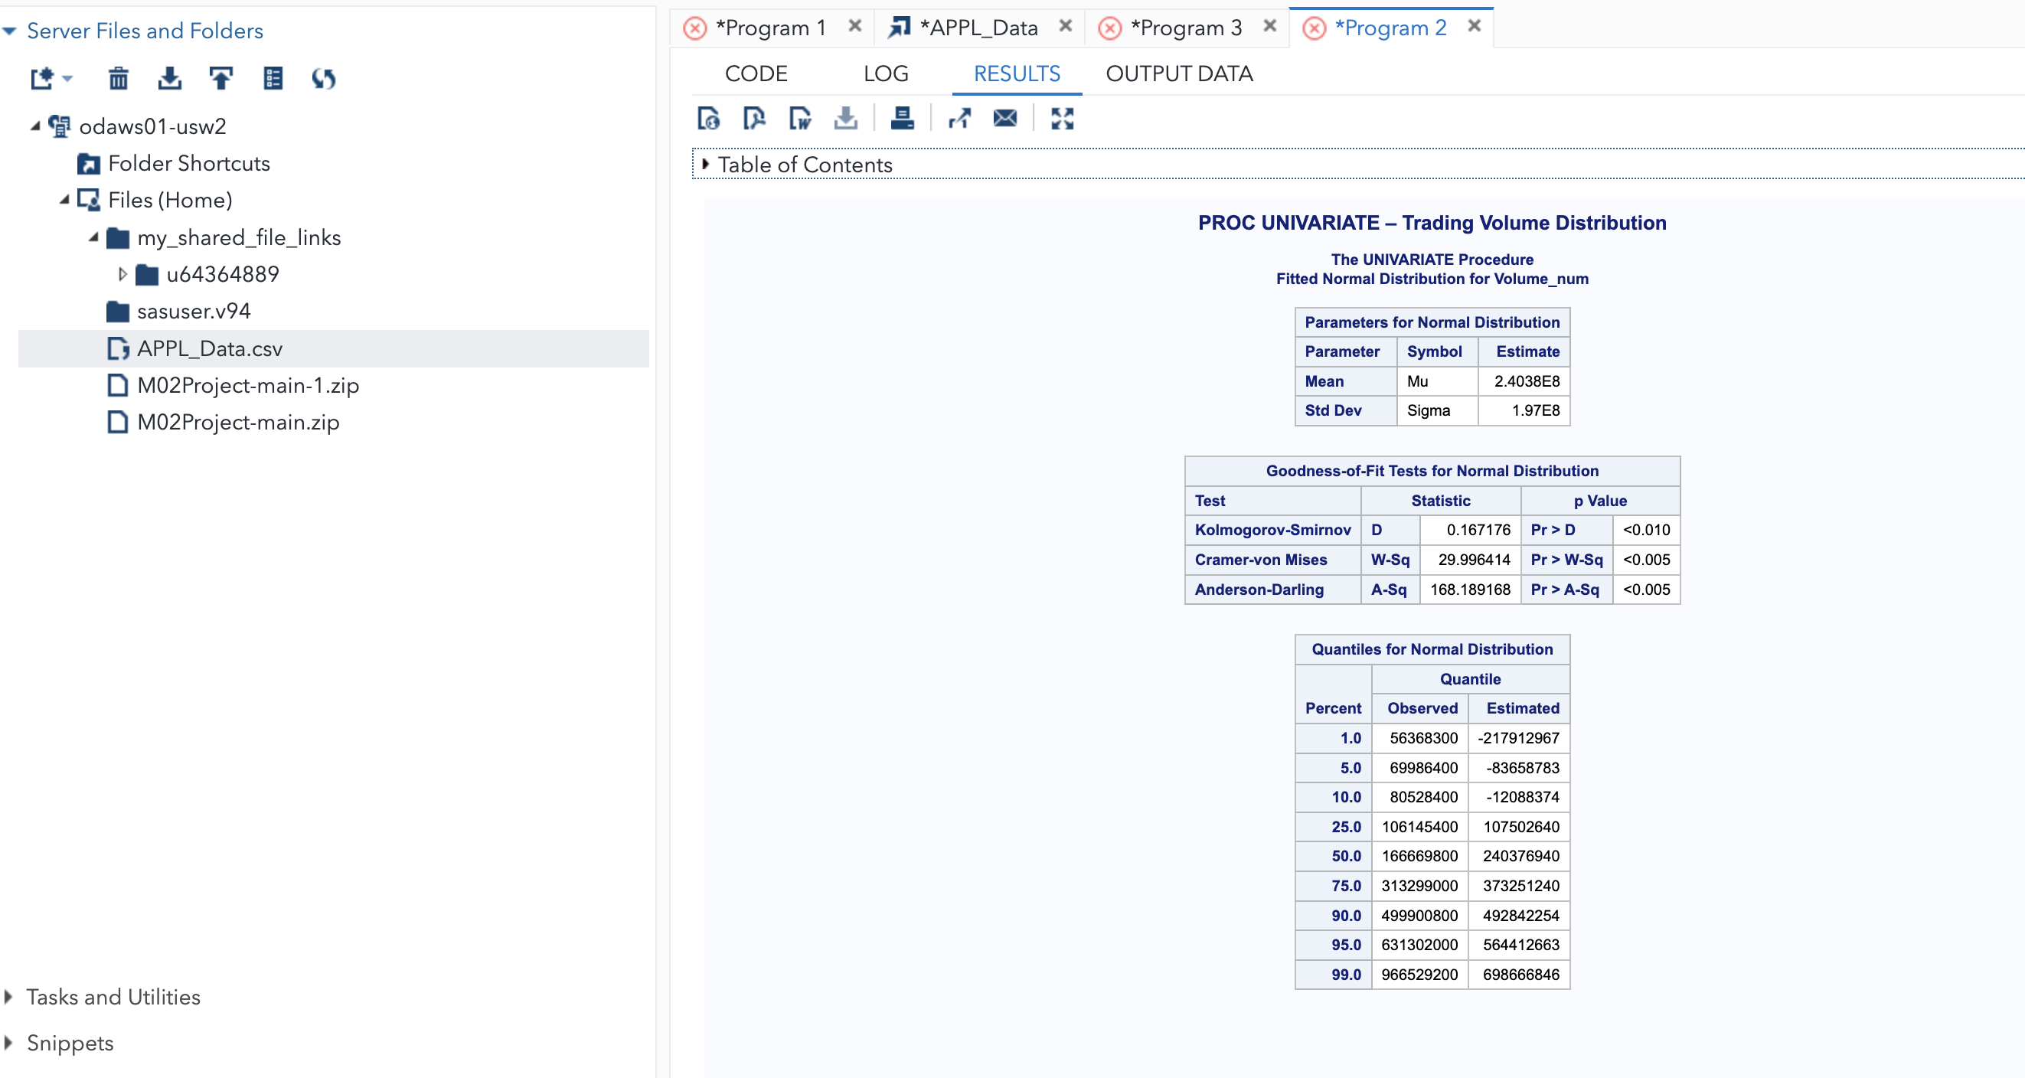
Proc Univariate
PROC UNIVARIATE provides a detailed statistical analysis of the trading volume, including distribution shape, summary statistics, and a histogram with a fitted normal curve. The exact code ran can be referenced in slide 4. Below is the output:

Slide 7

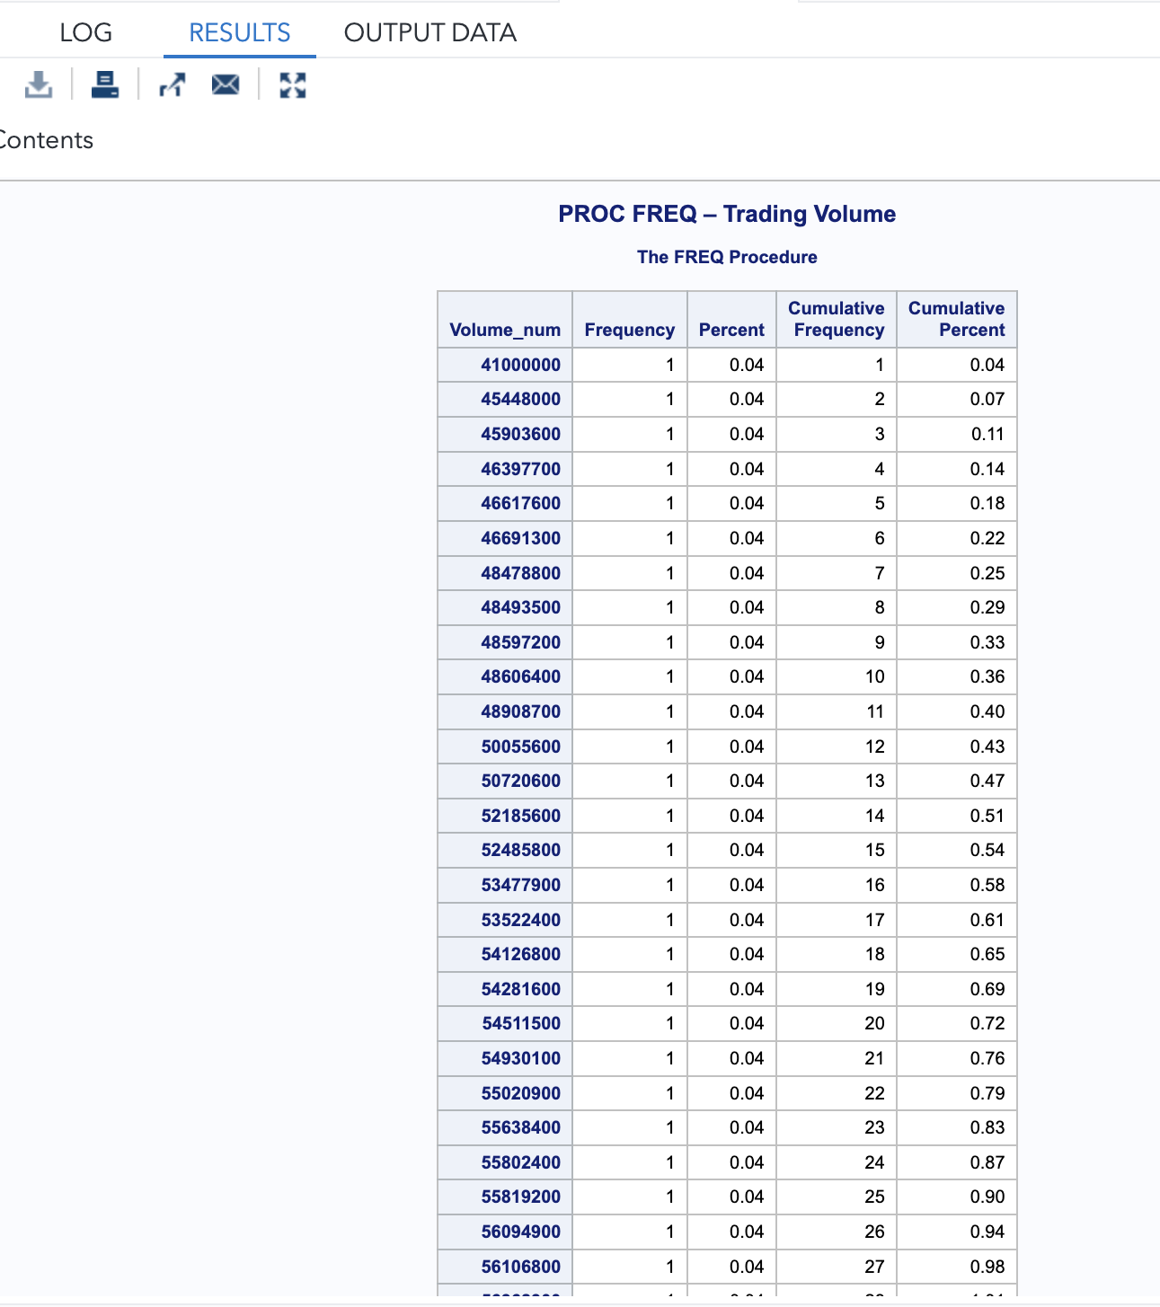
Proc Frequency
PROC FREQ was used to generate a frequency distribution for the trading volume variable. This shows how often values occur within the dataset. The exact code ran can be referenced in slide 4. Below is the output:

Slide 8
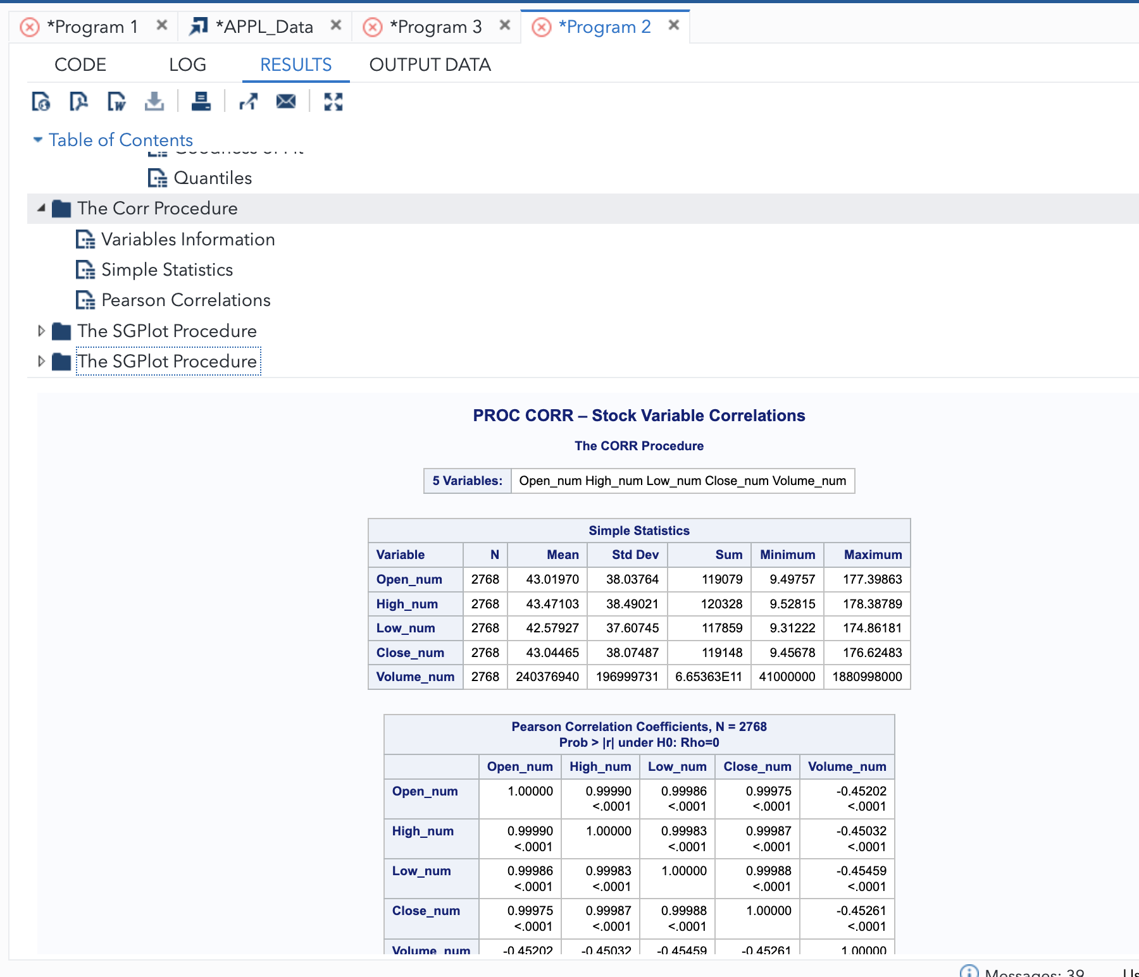
Proc Correlation Analysis
PROC CORR was used to measure the strength and direction of relationships between stock price variables and trading volume. The exact code ran can be referenced in slide 4. Below is the output:

Slide 9
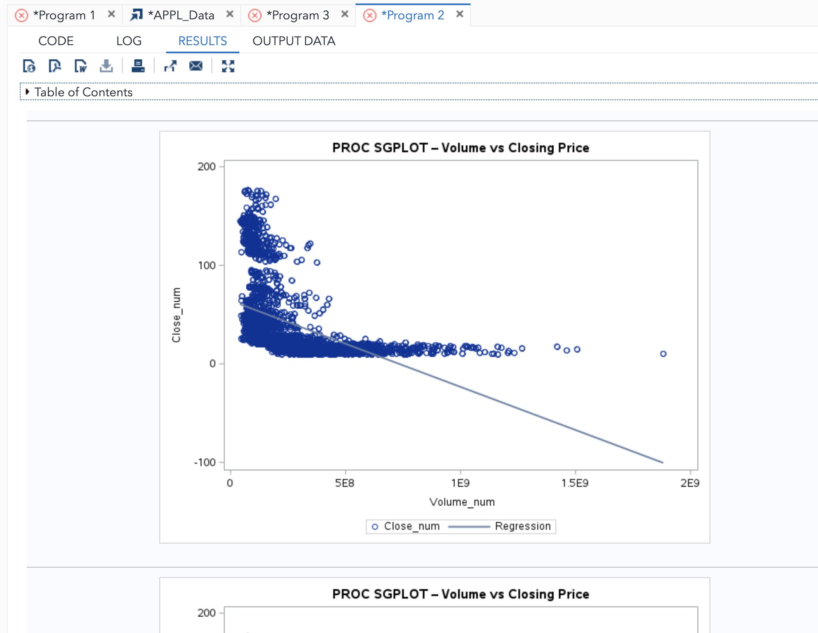
Proc SGPLOT Data Visualization
PROC SGPLOT was used to visualize the relationship between trading volume and closing price using a scatter plot and regression line. The exact code ran can be referenced in slide 4. Below is the output:

Slide 10

Thank you for your time, Dr. Ahmeti ☺

